Slide 1
Pesticide Hazards
in
Outdoor Marijuana Grows
Robert Ford CIH,CSP
Environmental Program Manager
California Department of Pesticide Regulation

Slide 2
Pesticide Exposures to Law Enforcement
2014
-Drug task force officer developed rash on arms after removing plants in marijuana grow.
-Five US Forest Service employees exposed to a “pink liquid” used to kill wildlife while cutting plants. Flu like symptoms persisted up to two weeks. Sought medical care.
-National guard member developed headache and breathing problem after removing plants in a grow site. Possible exposure to methamidophos.
-CDFW warden exposed to carbofuran while working in marijuana grow. Developed chest pain, breathing difficulty, nausea. Sought medical care.
Source: DPR Pesticide Illness Surveillance Database

Slide 3
Photos: CDFW

Slide 4
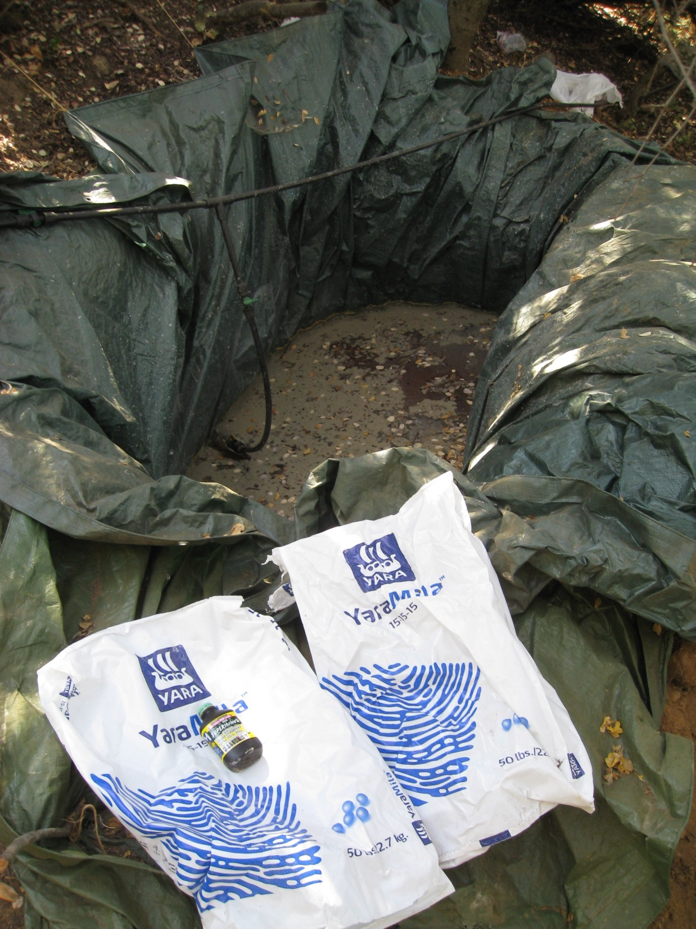

Slide 6
Routes for Pesticide Exposure
Entering gardens recently treated
Removing plants with residual product
Cutting/moving drip lines
Dismantling holding ponds
Helicopter down draft
Opening containers
Searching refuse

Slide 7
Pesticide Labels Signal Words
Pesticides have been found with banned or restricted use in the US
Label identification can help specify toxicity
DANGER POISON Poison in red letters with skull and crossbones Highly toxic/fatal (taste to 1/8 oz) through inhalation, absorption, ingestion or corrosive to eyes and skin
WARNING Moderately toxic (1/8 to 1 ounce), severe potential for irritation to skin and eyes (clearing in 8 to 21 days)
CAUTION Slightly toxic (ounce to pint) through ingestion, moderate potential for skin and eye irritation

Slide 8
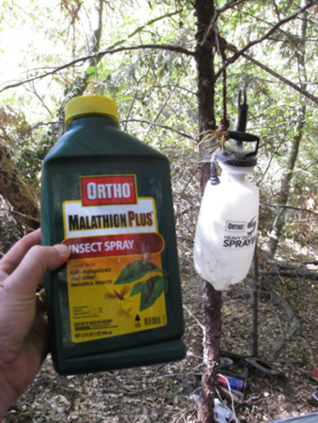
Organophosphate Pesticides
Cholinesterase inhibitor
Fat soluble
Absorb well through the skin, mucous membranes, eyes, and respiratory system
Include:
Methyl Parathion Restricted use pesticide (Metaphos or Metafos)
Not registered for Use in California Methamidophos Restricted use pesticide (Monitor, Tamaron)
Not registered for Use in California
Malathion
Non-restricted use

Slide 9
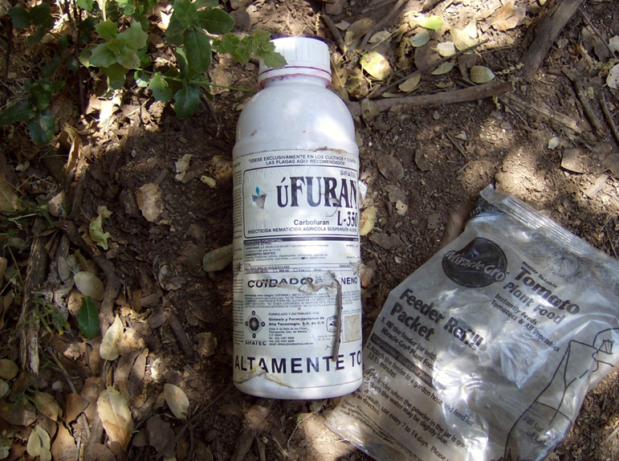
Carbamate Pesticides
Cholinesterase Inhibitor
Include:
Carbofuran
Restricted use pesticide (Furadan, Furan)
Not registered for Use in California
Banned by Federal EPA
Carbaryl
Restricted use pesticide except for home-use bait formulation (Sevin-5)

Slide 11
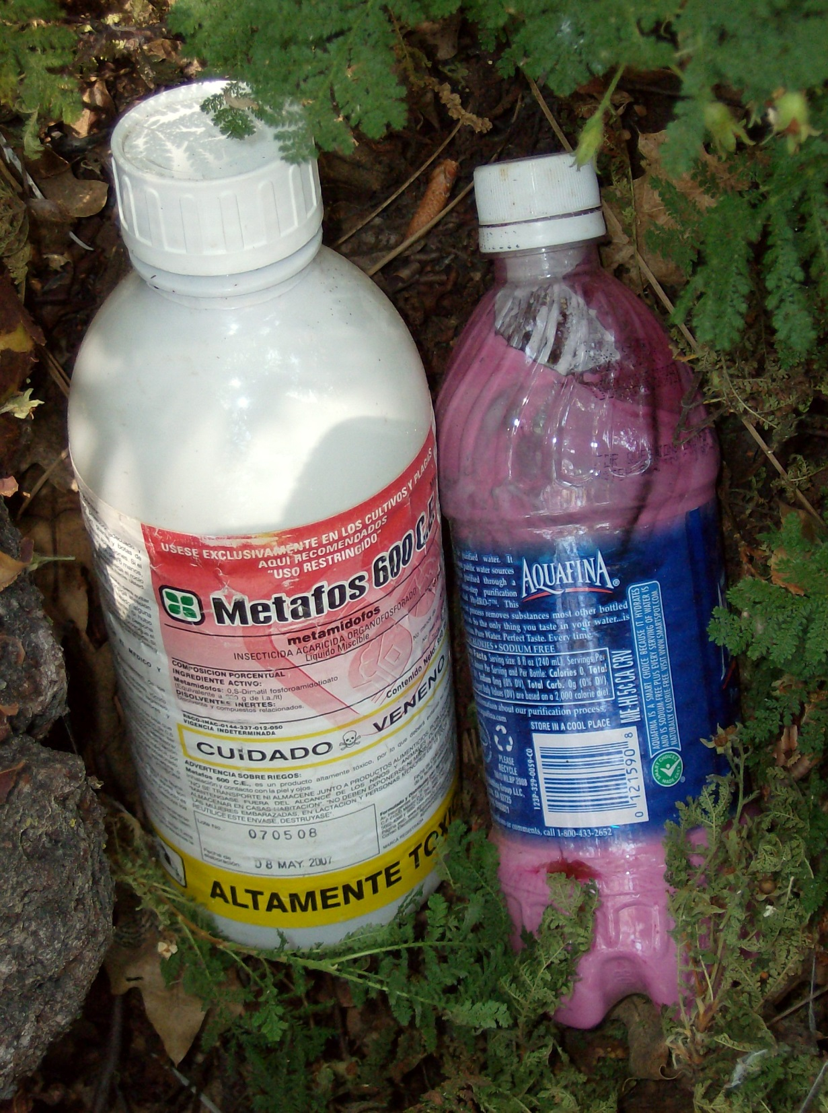
Of Major Concern
Carbofuran in water bottles
Placed in plastic bottles and sprayed on ground and plants to kill wildlife through absorption and ingestion
Also highly toxic to responding personnel

Slide 12
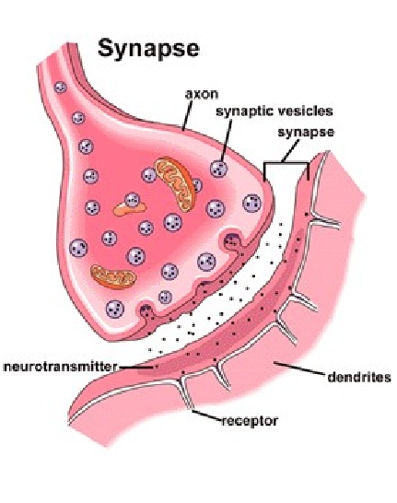
Cholinesterase Inhibition
Effect on nervous system synapses in humans, vertebrates, and insects.
Synaptic Gap
Stimulating signals are carried across the synapse by acetylcholine. Signals are cancelled by acetylcholinesterase
Cholinesterase inhibiting chemicals interfere with the cancelling of the nerve impulse allowing the impulse to continue resulting in uncontrolled rapid twitching of muscles, paralyzed breathing, convulsions, and death to the organism.

Slide 13
Generalized Symptoms of Exposure Cholinesterase Inhibiting Pesticides
Mild- tiredness, weakness, dizziness, nausea and blurred vision
Moderate- headache, sweating, tearing, drooling, vomiting, tunnel vision, and twitching
Severe- abdominal cramps, muscular tremors, pinpoint pupils, abnormally low blood pressure, slow heartbeat, breathing difficulty.

Slide 14
Requirements for Cholinesterase Inhibiting Pesticide Use
In agriculture, anyone who regularly mixes, loads, or applies an OP or carbamate pesticide with the signal words “Danger” or “Warning” must be under a medical supervision program (CCR T3,§6728)
Pre-exposure baseline cholinesterase should be established for individuals before they come in regular contact with organophosphate and carbamate pesticides.

Slide 15
Rodenticides
Aluminum and Zinc Phosphide (Ratone, Commando)
Applied as bait or dust
Red or pink in color
Reactive with water and/or acid
“DANGEROUS WHEN WET”
Very toxic if swallowed or dust inhaled
Not easily absorbed through skin
Works by releasing phosphine gas when ingested or inhaled
Causes pulmonary edema (fluid buildup) in lungs

Slide 17
Rodenticides
Symptoms not immediate, may occur up to 24 hours later
Exposure symptoms include; -”feeling cold” all over -chest tightness, abdominal pain
Avoid handling containers when possible
Do not handle containers or bait with bare hands
Wash hands immediately after handling

Slide 18
Rodenticides
Coumarin-type anticoagulants (TALON G)
Grain like, green pellets
Designed to cause internal bleeding after repeated ingestion
Does not absorb through skin
Do not handle product with bare skin
Avoid breathing dust

Slide 20
Rodenticides
Strychnine
OSHA exposure limit 0.15 mg/m3
Lethal dose in humans ranges from 30 to 120 mg (approx. 15% of 1 lb container)
Exposure easily controlled
Do not handle containers with bare hands
Avoid breathing dust
Wash off contamination as soon as possible

Slide 22
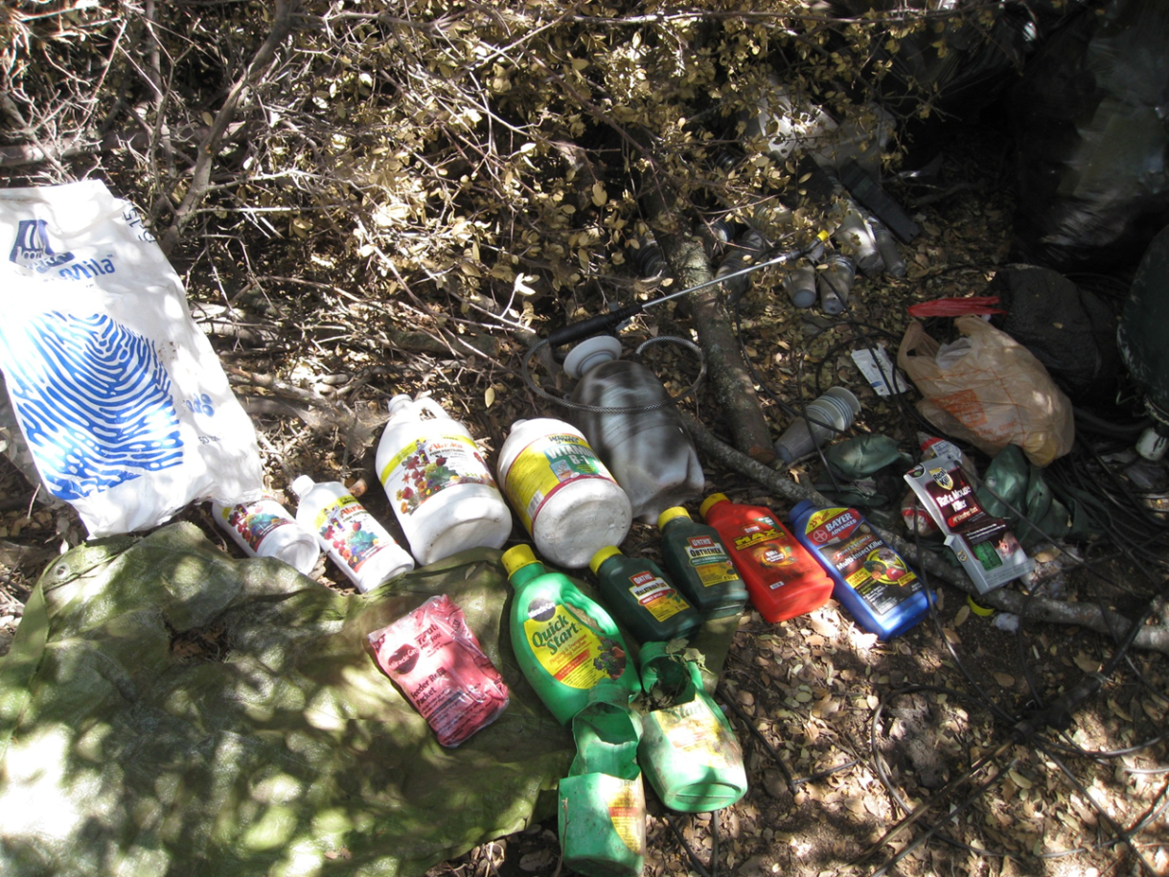
Protecting Yourself
CCR Title 8, Section 3380 “Personal Protective Devices”
Requires employees to use the type of PPE needed that will protect them from the hazards found
Granular Pesticides Other Solids Dust mask (N, R, P)
Impervious Gloves (SDS or label)
Field sanitation water for washing rinsing contamination

Slide 24
Provided as a cooperative agreement between Oregon State University and the U.S. Environmental Protection Agency. 1.800.858.7378 npic@ace.orst.edu

Slide 25
Questions?

